Slide 1

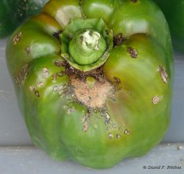
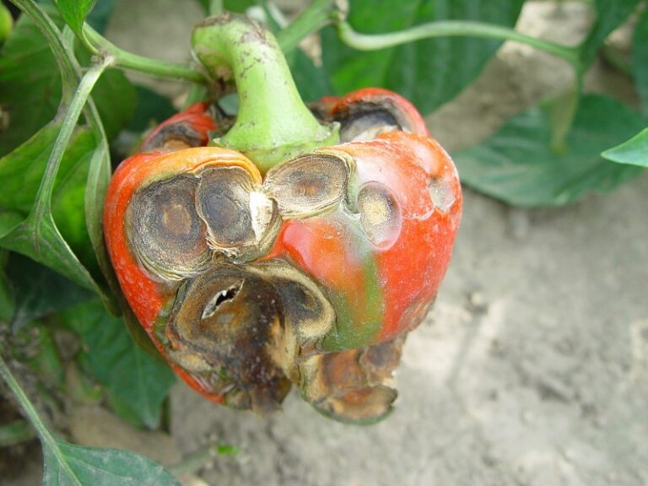
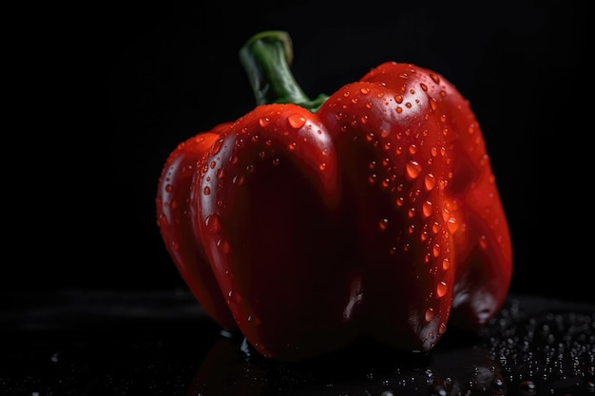
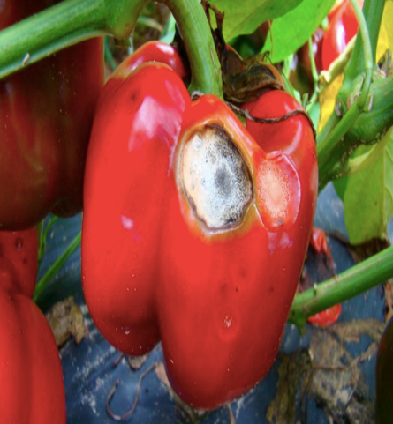
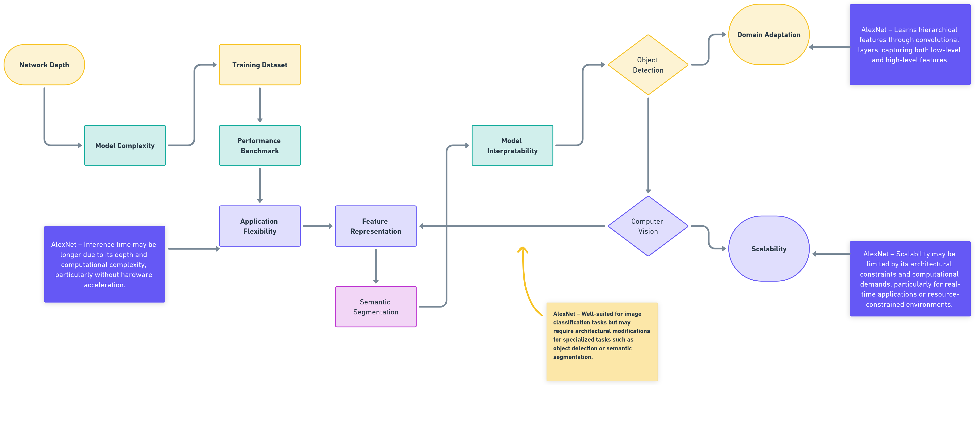
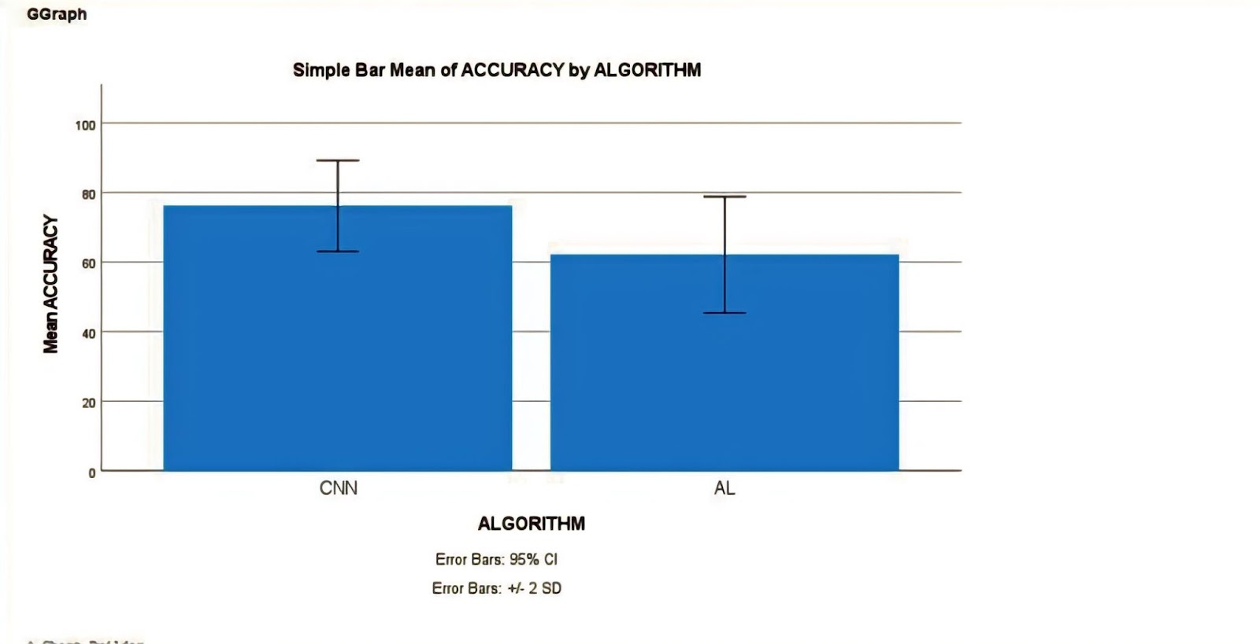
Name : Mr. Vigneshwaran P Register Number : 192124181
Guided by : Dr. C. Chandravathi
Ms. Poorani.S
Guided by Dr. Mary Valantina. G
Peppercheck: Deep Learning-based Bell Pepper Detection Disease using a Convolutional Neural Network and AlexNet in Random forest along identification and Management of Various disease affecting bell pepper plants.
INTRODUCTION
The detection of diseases in bell peppers is crucial for ensuring crop health and productivity. In this study, we explore the efficacy of Convolutional Neural Networks (CNNs) and AlexNet, a pioneering deep learning architecture, for this purpose. CNNs are renowned for their ability to learn hierarchical representations directly from images, while AlexNet, with its deep architecture, has demonstrated remarkable performance in image classification tasks.
By comparing these two models, we aim to discern their strengths and weaknesses in identifying diseases affecting bell peppers. Through comprehensive evaluation and analysis, we seek to determine which model offers superior accuracy, robustness, and efficiency in disease detection.
This research holds significant implications for agriculture, providing insights into advanced technology applications for crop disease management. Through this study, we aim to contribute to the development of more effective and reliable systems for early detection and mitigation of diseases.
Bell pepper cultivation, ultimately fostering sustainable agriculture practices and food security. This research endeavors to pave the way for more effective and efficient disease mitigation strategies in bell pepper cultivation.
Bell Pepper Detection Disease
MATERIALS AND METHODS
RESULTS
In comparing the results of disease detection in bell peppers using CNN and AlexNet architectures, several key findings emerge. The CNN model demonstrates strong performance, achieving a high accuracy rate in identifying various diseases affecting bell peppers. Its ability to learn intricate features from images contributes to reliable detection outcomes.
The trade-off between complexity and performance is evident, with CNN excelling in accuracy while AlexNet offers a broader understanding of image features. Overall, both architectures show promise in disease detection, with CNN's precision making it particularly well-suited for practical applications in agriculture. Further research and fine-tuning may leverage the strengths of both models for enhanced disease management in bell pepper cultivation.
AlexNet's performance highlights the potential for leveraging deeper architectures in future iterations, with opportunities for optimization and refinement.
CNN and AlexNet
Detecting bell peppers in images using Convolutional Neural Networks (CNN) and AlexNet Algorithm involves training these models on a dataset monitoring performance on the validation set to prevent overfitting. Use evaluation metrics such as accuracy and precision disease management is crucial for sustaining bell pepper production and ensuring food security
DISCUSSION AND CONCLUSION
Based on T-test Statistical analysis, the significance value of p=0.001 (independent sample T - test p<0.05) is obtained and shows that there is a statistical significant difference between the Group 1 and Group 2.
Overall , the accuracy of the Convolutional Neural Networks (CNN) is 91.75% and it is better than the AlexNet. Models undergo training on the training set, with adjustments made based on validation performance.
Convolutional Neural Networks (CNN) - 91.75%
AlexNet Algorithm - 87.80%
From the work, it is concluded that Convolutional Neural Networks (CNN) consistently demonstrate superior accuracy compared to AlexNet in the detection of bell pepper, highlighting the robustness and effectiveness of CNN architectures for image recognition tasks in agricultural contexts. A decision is then made between CNN and AlexNet architectures based on computational resources and performance requirements. The dataset is divided into training and validation sets, with potential augmentation techniques applied to increase variability.
BIBLIOGRAPHY
Bargoti, S., & Underwood, J. (2017). "Deep Fruit Detection in Orchards." IEEE Robotics and Automation Letters, 2(4), 2093-2100. This paper presents a deep learning approach for fruit detection in orchards using convolutional neural networks (CNNs). The authors demonstrate high accuracy in detecting fruits under challenging environmental conditions, offering valuable insights for automated harvesting systems.
Ramcharan, A., et al. (2017). "Deep Learning for Image-Based Cassava Disease Detection." Frontiers in Plant Science, 8, 1852. This study explores the use of deep learning techniques for detecting diseases in cassava plants through image analysis. The research demonstrates the potential of deep learning models in accurately identifying various cassava diseases, providing a promising avenue for improving crop management practices.
Ghosal, S., et al. (2018). "An Explainable Deep Learning Framework for Disease Detection in Plant Leaves." Scientific Reports, 8(1), 2793. This paper introduces an explainable deep learning framework for disease detection in plant leaves, addressing the need for interpretable machine learning models in agriculture
Sa, I., et al. (2016). "DeepFruits: A Fruit Detection System Using Deep Neural Networks." Sensors, 16(8), 1222. This research presents DeepFruits, a system for fruit detection using deep neural networks. The study demonstrates the effectiveness of deep learning in accurately detecting fruits in images captured under varying conditions, offering potential applications in agriculture and food industry automation.

